Slide 1
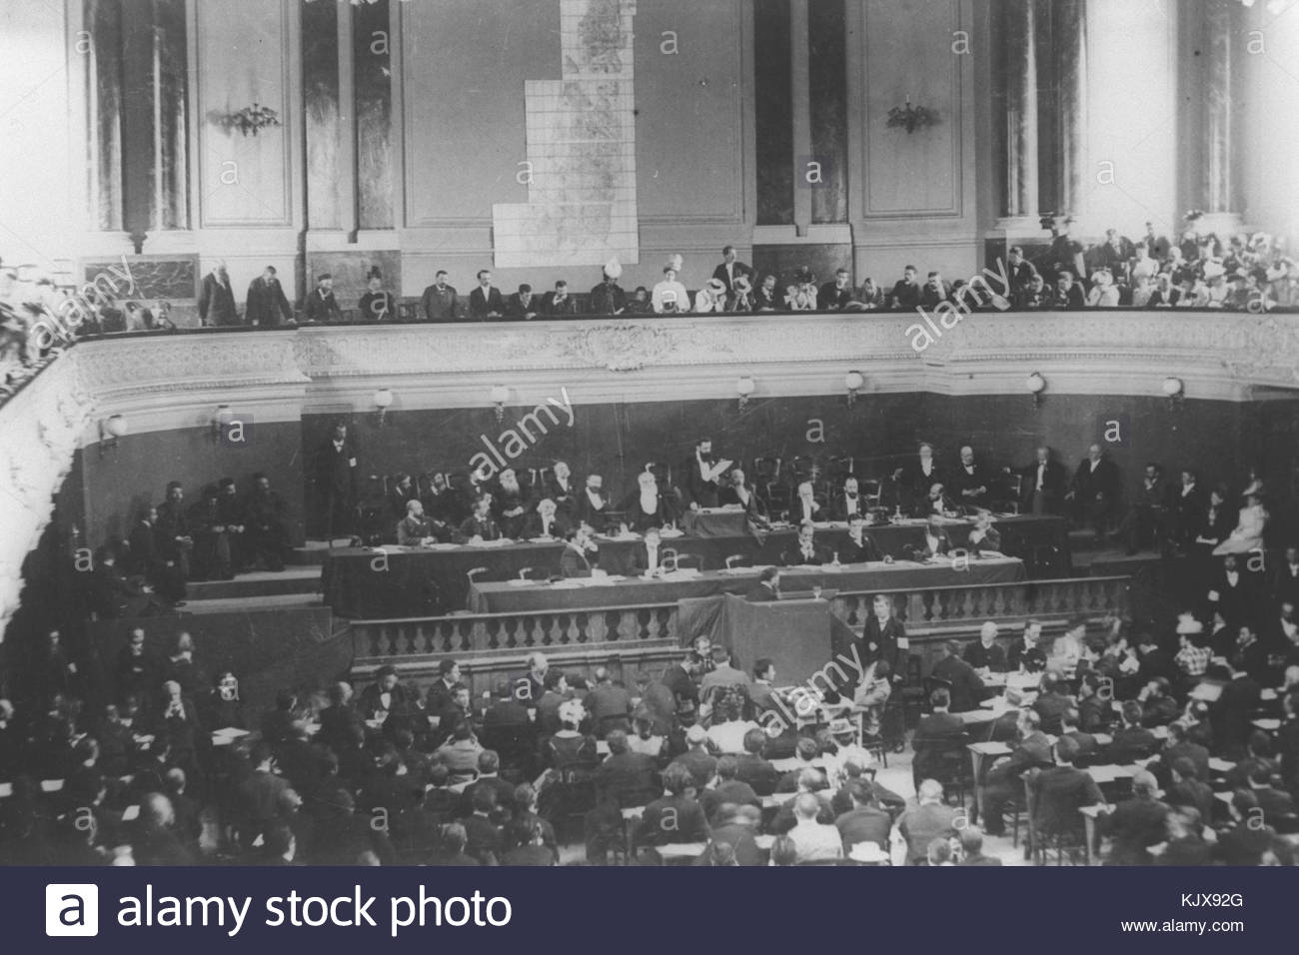
Why was Zionism established in the nineteenth century?
Lesson 2

Slide 2
Learning objectives
By the end of this lesson, you should be able to:
  Define Zionism
  Explain why Zionism was established in the nineteenth century
  Evaluate the support and opposition to Zionism at this time

Slide 3
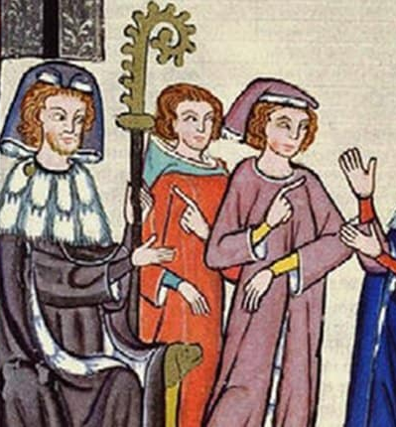
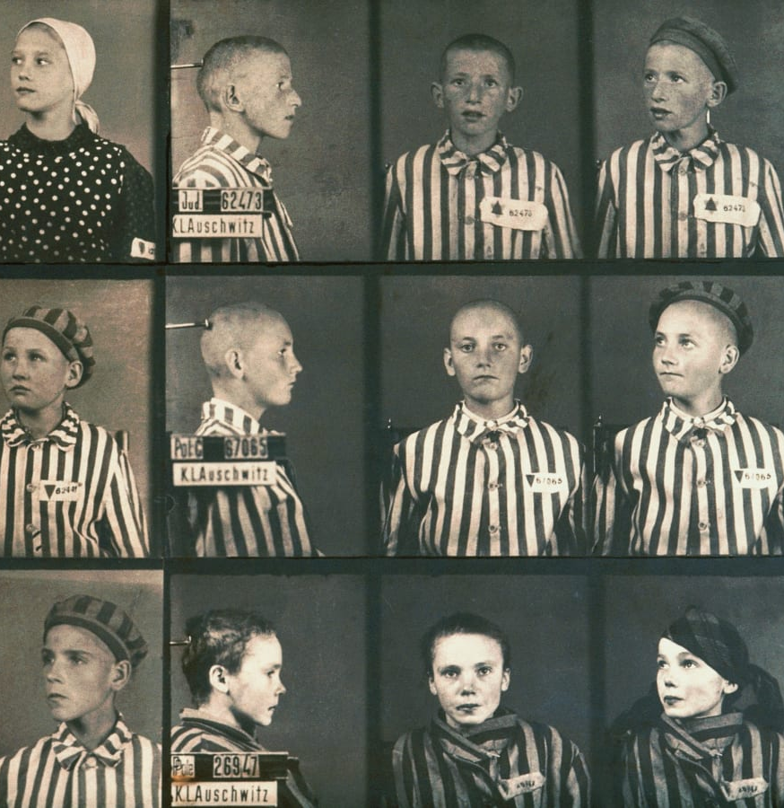
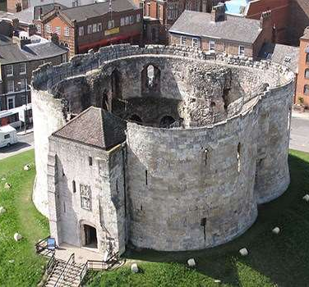
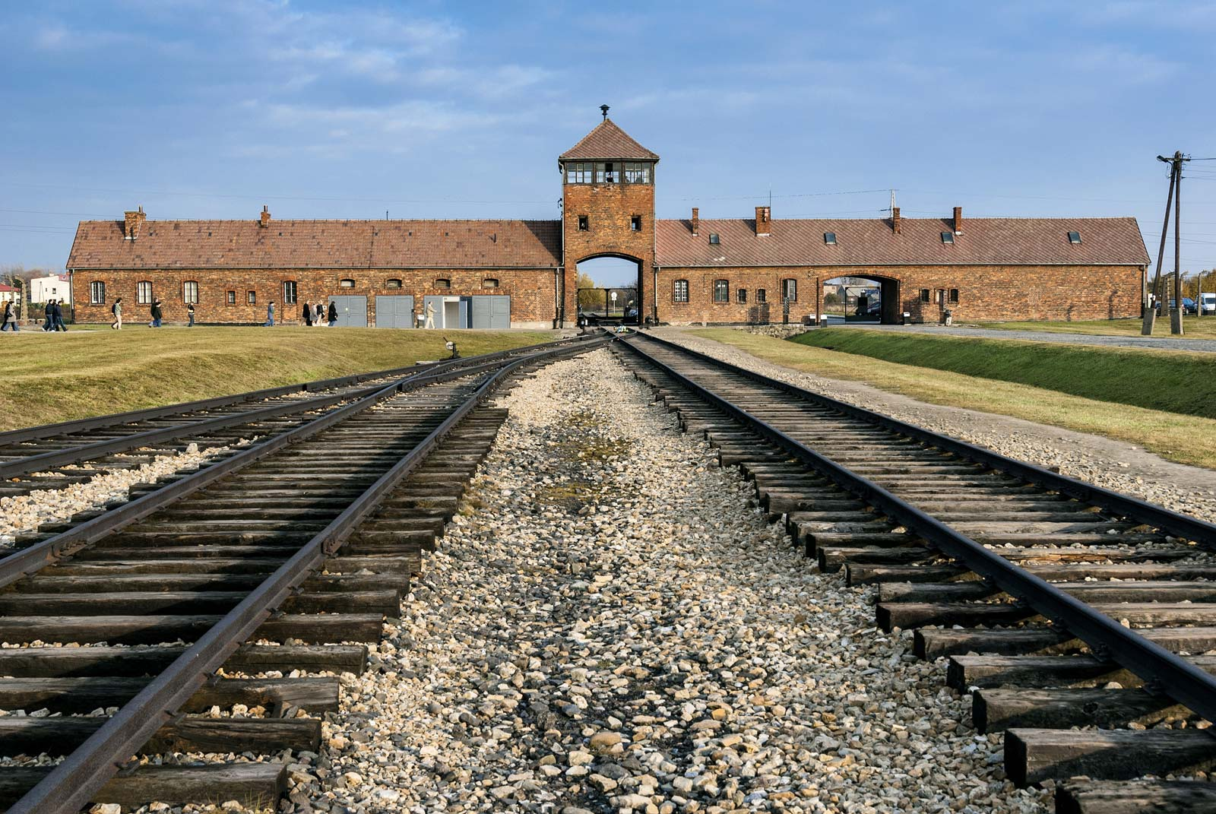
Starter activity
Medieval clothing laws
The Holocaust
In small groups, think about these questions:
What does it mean to be Jewish?
What is antisemitism?
Can you think of any examples of antisemitism from history? Use the images to help you
12C massacre in York
Auschwitz-Birkenau

Slide 4

Antisemitism today

Slide 5
How would you define these terms?
Jewish
Antisemitism
Judaism

Slide 6
Add these keywords with their definitions to your glossary
Jewish: someone who identifies as Jewish by religion or ethnicity
Judaism: a religion that is nearly 4000 years old
Antisemitism: hostility, prejudice or discrimination against someone because they are Jewish

Slide 7
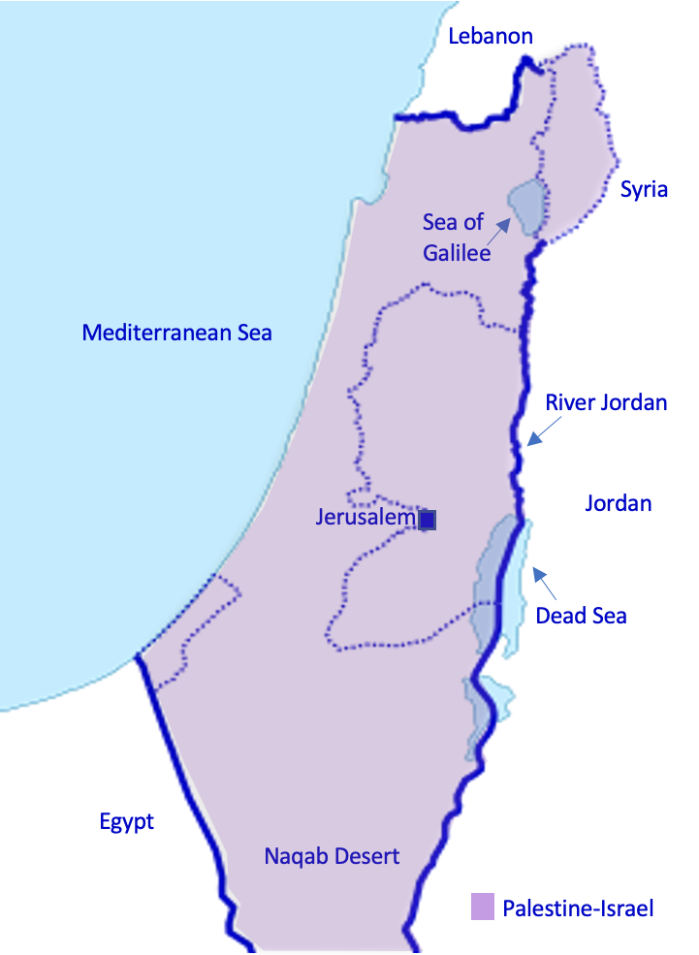
Add these keywords to your glossary too
Pogrom: a violent attack on Jews
Zionism: a nationalist movement to establish a Jewish state between the Mediterranean Sea and the River Jordan (in Palestine-Israel)

Slide 8


A brief history of antisemitism
There is a very long history of this form of racism
The earliest examples go back to the days of the Bible
The first records of Jews in England go back to 1070, when they were invited to settle in England by William the Conqueror
Between 1290 and 1656, Jews were banished from England
In the 1800s and early 1900s, a wave of pogroms (violent attacks on Jews) swept across the Russian Empire
Antisemitism is still a big problem today, in Britain and elsewhere

Slide 9
2a. Create a timeline of antisemitism in Europe from 1070 to the early 1900s using these information cards:
During the reign of King Henry III of England in the 1200s, antisemitic laws were passed. This included a law that Jews must wear a badge of shame to distinguish them as Jewish.
Does this remind you of anything?
In York, England in 1190, the city’s entire Jewish population was trapped inside the tower of York Castle and massacred
Across Europe in the 1400s, during times of disease, Jews were accused of poisoning local rivers and wells. They were often forced to live in Jewish-only ghettos
Across Europe in the 1100s, Jews were not allowed to own land. This meant that they couldn’t be farmers, so they often lent money instead. This is where the antisemitic stereotype of Jews as money lenders comes from
In the 1800s and early 1900s, a wave of pogroms (violent attacks on Jews) swept across the Russian Empire. For example, during the Kishinev pogrom of 1903, 49 Jews were killed
In 1290, Jews were banished from England. They were not allowed to return until 1656
For more on antisemitism during the medieval period, see the video on the next slide
In 1492, Jews were banished from Spain
Extension: What aspects of Jewish life were impacted by this antisemitism?

Slide 10
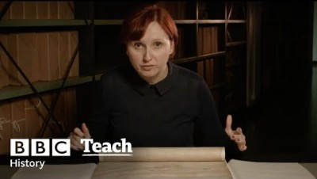
Watch up to 02:46 on antisemitism in the medieval period
Add any relevant information to your timeline

Slide 11
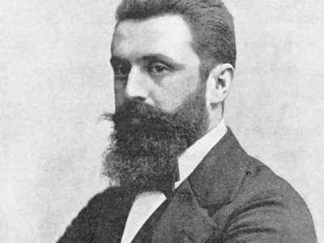
Why did Zionism emerge in the nineteenth century?
Your timeline shows the long history of antisemitism, up to the Russian pogroms of the 1800s
It was in this context that some Jews began calling for their own state → this is Zionism!
Before this, the Jewish community was diasporic. This meant that Jews lived across the world but they retained a connection to the land of Palestine-Israel, which they were expelled from between 8 BCE and 6 BCE (around 2000 years ago)
The Zionists were also inspired by other nationalist movements at this time - for example the USA (1776) and France (1792)
Theodor Herzl (pictured) is seen as the founder of the modern Zionist movement
In 1897, Herzl organised the First Zionist Congress (also pictured) in Basle, Switzerland
Alaska and Uganda were considered as territories for a future Jewish state, but Palestine-Israel (then home to the Palestinians, as we saw last lesson) was the most popular choice
Can you see any potential problems here?

Slide 12

Watch 00.17-01.22 for more about Zionism

Slide 13
Why did Zionism emerge in the nineteenth century?
Your timeline shows the long history of antisemitism, up to the Russian pogroms of the 1800s
It was in this context that some Jews began calling for their own state → this is Zionism!
Before this, the Jewish community was diasporic. This meant that Jews lived across the world but they retained a connection to the land of Palestine-Israel, which they were expelled from between 8 BCE and 6 BCE (around 2000 years ago)
The Zionists were also inspired by other nationalist movements at this time - for example the USA (1776) and France (1792)
Theodor Herzl (pictured) is seen as the founder of the modern Zionist movement
In 1897, Herzl organised the First Zionist Congress (also pictured) in Basle, Switzerland
Alaska and Uganda were considered as territories for a future Jewish state, but Palestine-Israel (then home to the Palestinians, as we saw last lesson) was the most popular choice
Using this information, write a paragraph to explain the causes of the emergence of Zionism in the nineteenth century

Slide 14
Did all Jews support the Zionist movement in the nineteenth century?
No. Some Jews supported Zionism and some Jews opposed it
‘Jewish’ is not the same as ‘Zionist’
Can you remember the difference?
Jewish: someone who identifies as Jewish by religion or ethnicity
Zionist: someone who supports the Jewish nationalist movement to establish a Jewish state between the Mediterranean Sea and the River Jordan (Palestine-Israel)

Slide 15
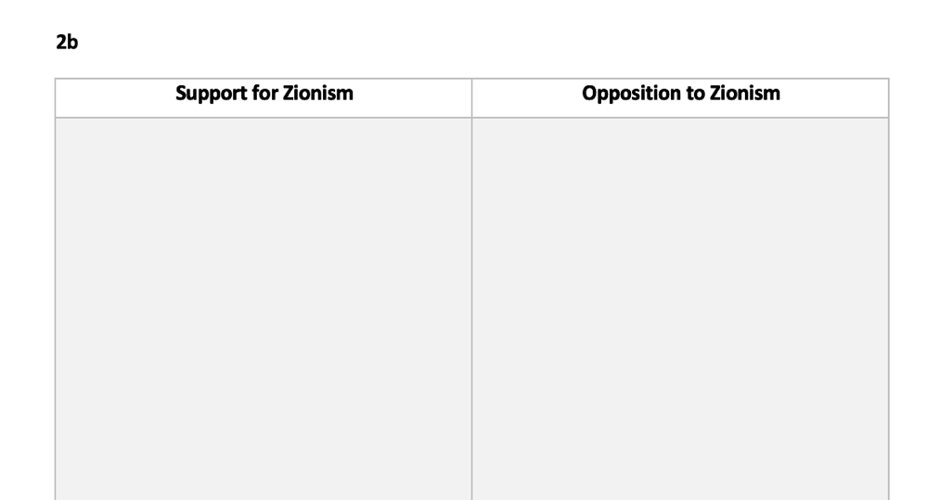
2b) Arguments for and against Zionism in the nineteenth century
Sort the cards below into two columns: support for Zionism and opposition to Zionism
c) Jews were expelled from the land of Palestine-Israel nearly 2000 years ago. They have a right to return now
a) Jews have been subject to antisemitism for centuries. The Jewish people now need their own state where they can live free from persecution
b) Rather than Jews moving to Palestine-Israel, antisemitism must be combatted in Europe and America. A Jewish state will only create more division between Jews and non-Jews across the world
d) The Palestinians have lived in Palestine-Israel for centuries. It is their home now
Extension: Which of these arguments do you find most convincing?

Slide 16
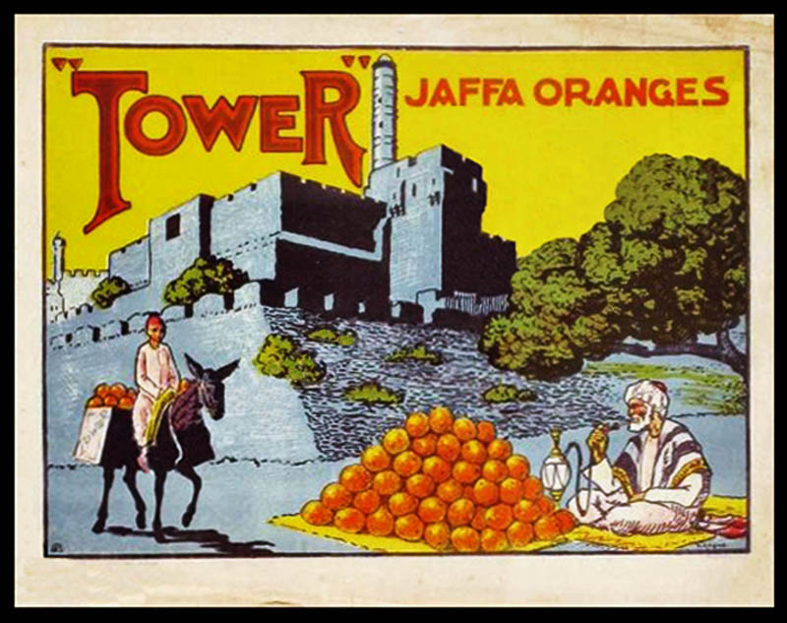

2c) Debating activity
You are now going to be assigned a partner. You and your partner are either ‘support’ or ‘opposition’ to Zionism. You can spend a few minutes preparing your argument
Then you will join with another pair and have a debate about Zionism in the nineteenth century
What can you use from this lesson and last lesson to support your argument?
Support for Zionism:
Jews have been subject to antisemitism for centuries. The Jewish people now need their own state where they can live free from persecution
Opposition to Zionism:
The Palestinians have lived in Palestine-Israel for centuries. It is their home now

Slide 17
How did you find this activity?
What made this debate difficult?
What did both sides have in common?

Slide 18
Plenary
Define:
Jewish
Judaism
Zionism
In pairs:
Can you give two examples of antisemitism in Britain between 1070 and the early 1900s?
Can you think of two reasons for the emergence of Zionism in the nineteenth century?

Slide 19
Homework
How would Zionism make you feel in the nineteenth century if you were:
Jewish
Palestinian
Write at least three sentences from each perspective
Looking at your notes from last lesson will help with writing the Palestinian perspective

